Slide 1
The Marketing Process Outsourcing Company
Creating Phygital Experiences

Slide 2
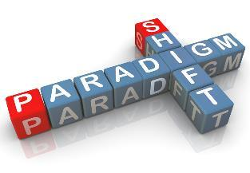
Who are we? What do we stand for?
We are not an event agency. We are not a BTL agency.
We Manage Campaigns. We create PHYGITAL experiences.
We work with the idea of “Marketing Process Outsourcing” – by providing 360 degree business linked marketing solutions and have been in this business since 2013
We facilitate businesses to outsource their entire Marketing and Brand requirements, right from the Strategy and Ideations, Conceptualizing, Creatives, Planning and Execution – with the support of the best marketing minds in the ecosystem.
We as a team here carry the experience of handling Brand and Marketing for some of the top Fortune 500 companies along with the backing of the best of the suppliers and vendors.

Slide 3

Offline Marketing
BTL
Retail & Merchandise Solutions
Brand, Marketing and Creative Consultancy
Consumer Promotions
Dealer Meets
Events
Activations
Trade Show, Seminars and Stalls
Offsite Conferences
Innovation in POSM and Brand Visibility
Retail Planogram
Merchandising and Real Time Online Tracking of deployment
Retail Pricing Audits and Mystery Shopping
Retail Merchandising
Retail Furnitures and Display Innovations
Trade Marketing Solutions
Phygital Marketing
ATL
Retailer Engagement
Online Loyalty Programs
Trade Incentive Programs
Gifting Solutions
Integration of BTL activation with digital space
Marketing App development
VR Integrated BTL Activations
Social / Digital Led Activation
Media Planning and Buying
OOH
Radio

Slide 4
Online Marketing
Social Marketing
Digital Marketing
Content and
Creative Development
Social Media Marketing
Marketing and Amplification on FB, Instagram, YouTube, Twitter
Social Pages Management
ORM
Influencer Marketing
Product / Brand Endorsement and Amplification using Key Opinion Leaders and Celebrities
Brand and Product seeding onto Online Media Platforms
Passive Marketing using neutral platforms
Digital Marketing
SEO, SEM
GDN, AdWords, DV360
Online Media Buying
Experiential Marketing
VR Integrated BTL Activations
App Based Solutions
Real Time Online Tracking of Merchandising / POSM deployment
Real Time Sale Incentive Solutions
Sales Relationship Management
Marketing App development
Content Creation
Infographics, Static Creatives, Videos, GIFs
Creatives
Creative Designs – 2D / 3D
Campaign, Portfolio and Product Design
Product Shoot / Photography / Videography
Video Editing
VFX
Chroma Shoots

Slide 5




















They believe in us…
References can be provided on request

Slide 6
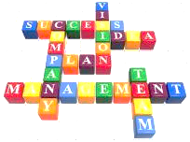
The Thinkers
Saurav Kundu
Offline Marketing
linkedin.com/in/sauravkundu
Brand and Marketing Specialist
Sujoy Roy
Online Marketing
linkedin.com/in/roysujoy
SEO & Online Marketing Strategist, Google Certified
Saurav carries with him a rich experience of more than 22+ years in brand and marketing. He had been leading and handling some of the top brands in India. He has worked in brands like HDFC Bank, TTSL, Nokia, Spice, LeEco. Saurav is the guiding force behind the company and focuses on creativity and innovation.
Sujoy heads the company’s Online Business and is the solutioner. He has 22+ years of experience in taking up the challenge of approaching the clients, communicating with them, understand their business & issues, suggest them IT solutions and managing teams who were responsible to execute the solutions. He has been associated with brands like Pepsi, World Bank, etc.

Slide 7
Offline Activity Snapshots

Slide 8
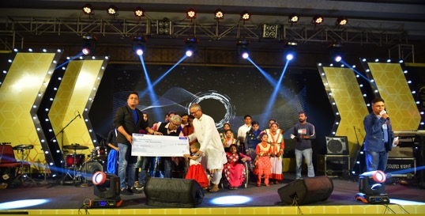
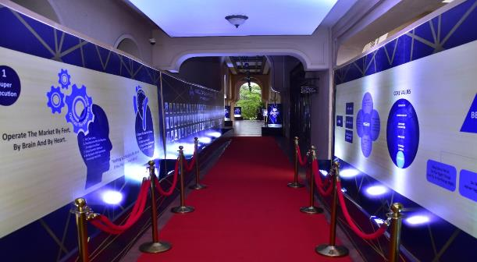
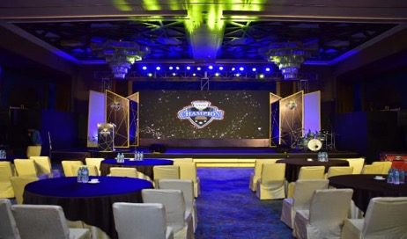
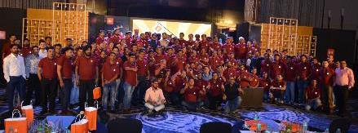
Corporate Events

Slide 9
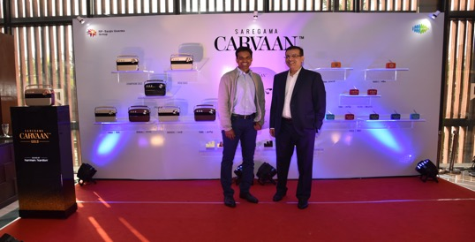
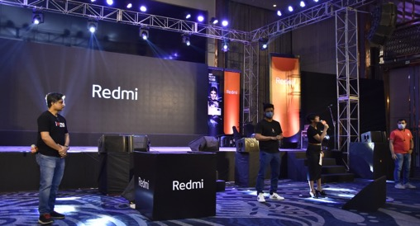
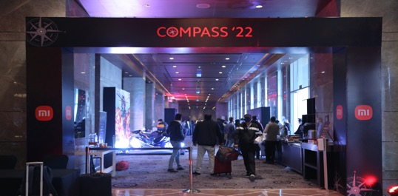
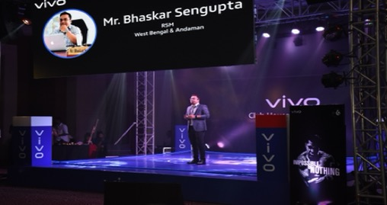
Corporate Events

Slide 10
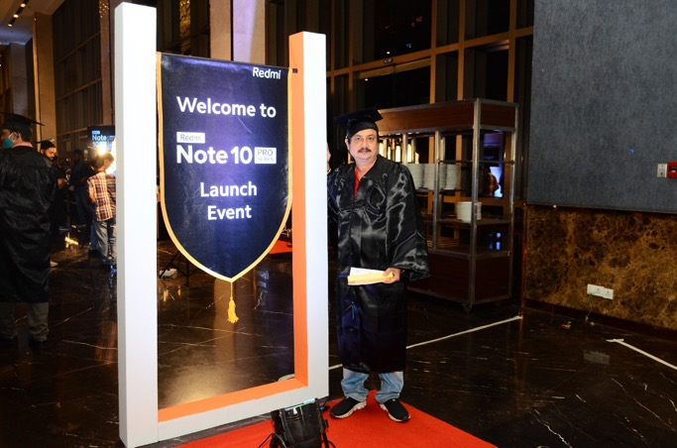
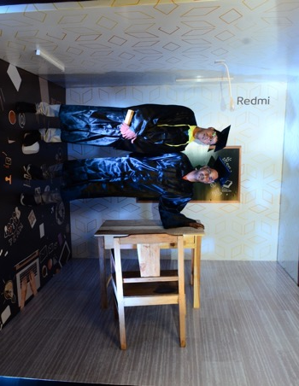
Corporate Events

Slide 11
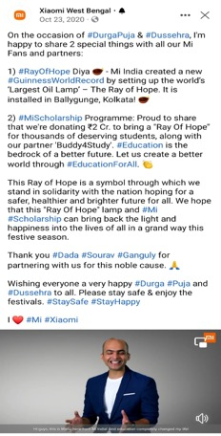
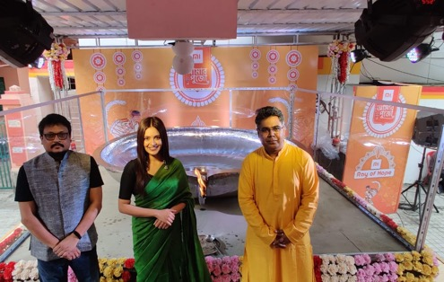
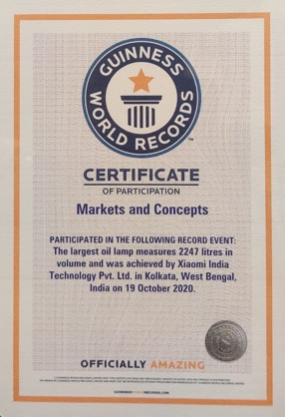
Creating World Records for Brands

Slide 12
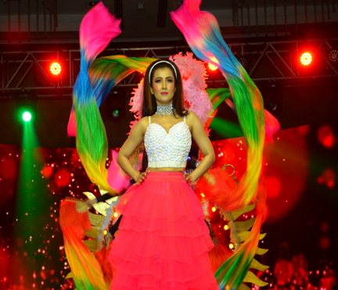
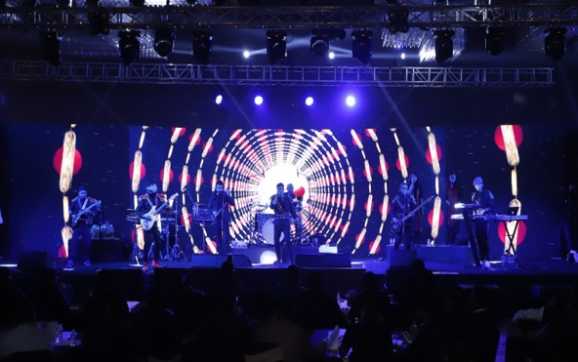
Corporate Entertainment

Slide 13
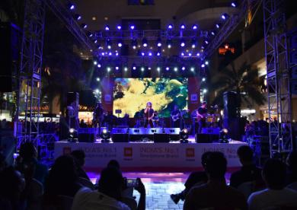
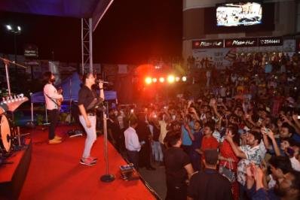
Music Concerts

Slide 14
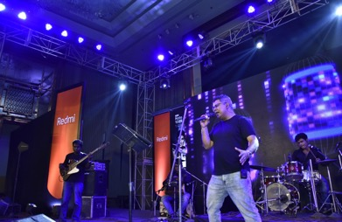
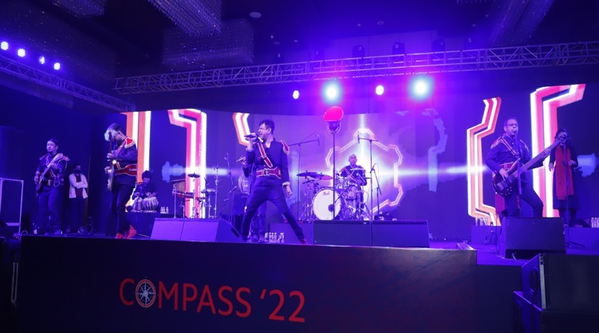
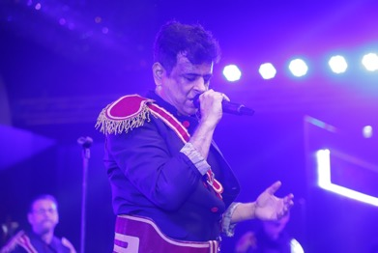
Music Concerts

Slide 15
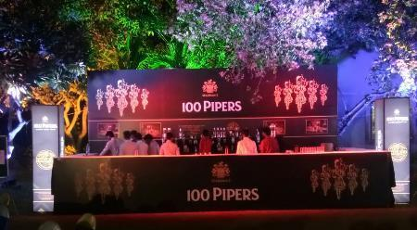
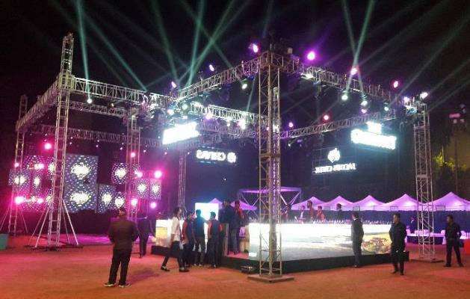
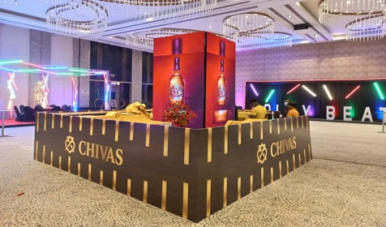
Brand Promotions

Slide 16
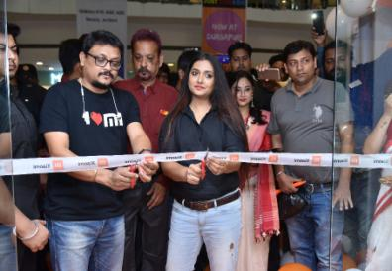
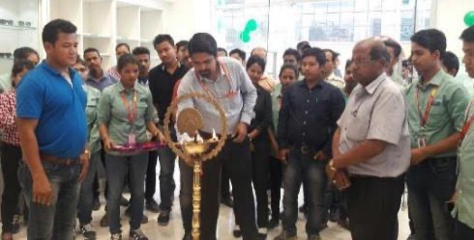
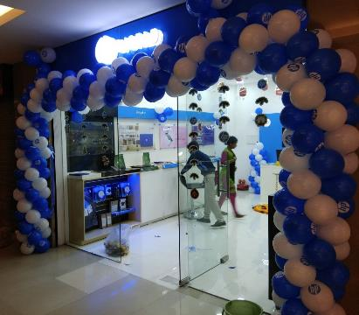
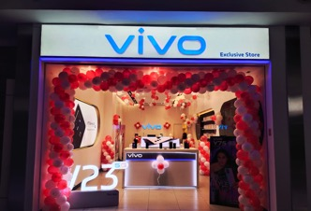
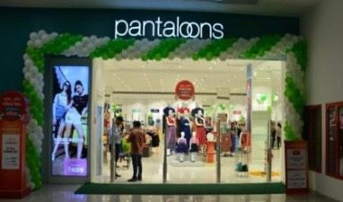
Store Launch

Slide 17
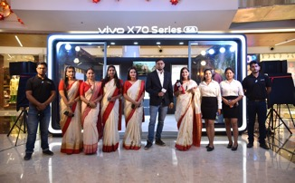
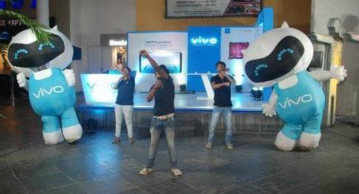
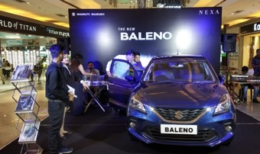
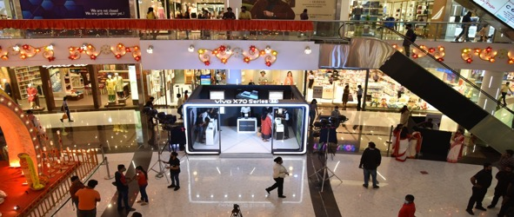
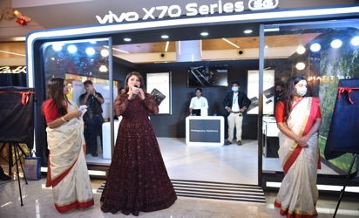
Mall Promo
South City Mall Activity Video: https://fb.watch/bkoNJpyxON/

Slide 18
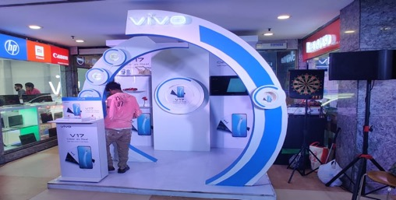
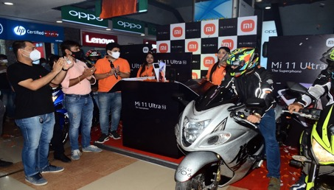
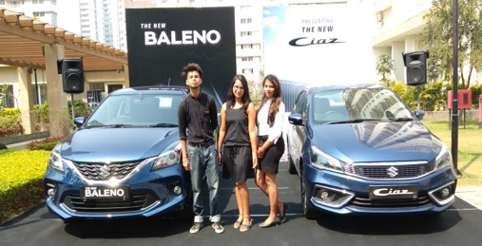
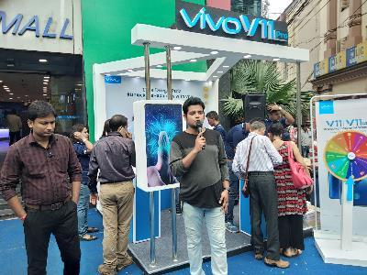
Road Shows

Slide 19
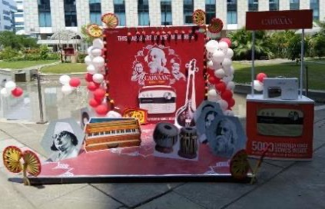
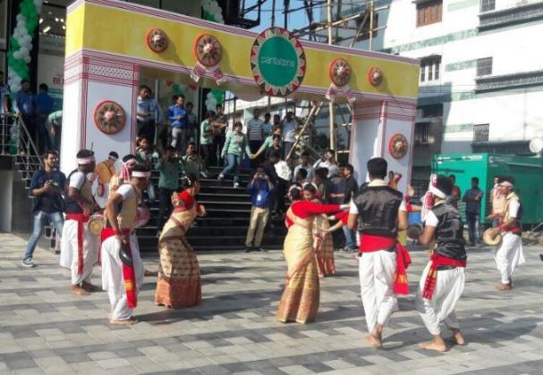
Festive Activations

Slide 20
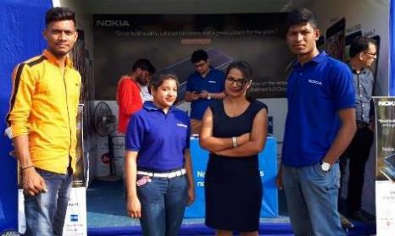
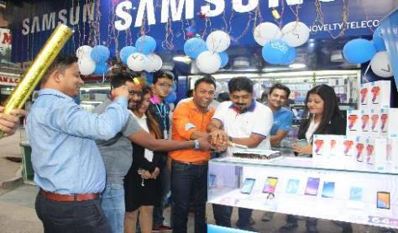
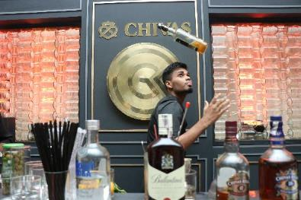
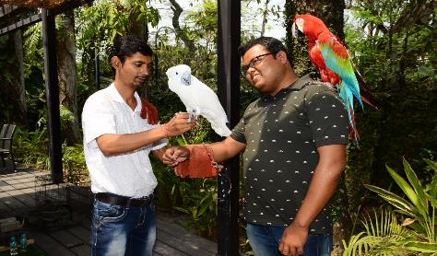
BTL Promotions

Slide 21
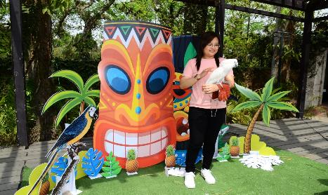
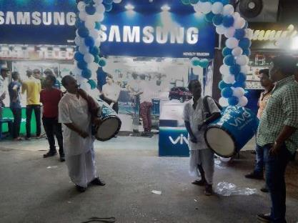
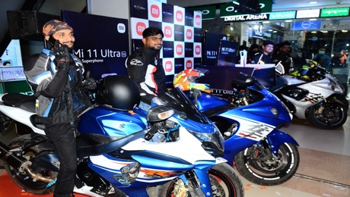
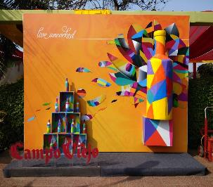
Themed Activations

Slide 22
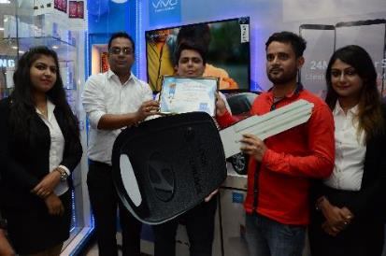


In Shop Promo – Demo and Lead Capture

Slide 23




Showroom on Wheels

Slide 24


Merchandising and Décor

Slide 25


Customised Design and Fabrication

Slide 26



Customised Design and Fabrication

Slide 27


Customised Design and Fabrication

Slide 28
Digital Activity Snapshots

Slide 29



Social Media Management
Full Spectrum Capabilities to manage Social handles for Brands
Social Media Management
  Handling the Social Pages of Xiaomi in East and West India
  17 State Handles
  22 Social Pages

Slide 30
Social Media Campaigns
Hilsa Festival Campaign with Food Blogger Foodka for Vivo
  https://www.facebook.com/watch/?extid=CL-UNK-UNK-UNK-AN_GK0T-GK1C&v=166644255566355
Liquor Home Delivery Campaign for Spencer’s Retail
  https://www.instagram.com/p/CH26l5FMh35/
Thai Food festival for Spencer’s Retail
  https://fb.watch/bko5uBUkxP/
Financial Influencer Campaigns for Khadim

Slide 31





Social Media Campaigns

Slide 32





Khadim Social Media Celebrity Campaign
Khadim Diwali Campaign on Instagram
Combined Campaign Views is in excess of 3.3 Mn Views on Social Handles of Khadim

Slide 33



Digital Campaigns
Geofencing Digital Campaigns - New Normal Retail Campaign for Xiaomi
QR Code Based Demo Campaign – Samsung Smart Cafe
Digital Consumer Promo - We are a full service agency when it comes to SMS based or QR Code Based consumer promo campaigns with full in house teams
  SMS Based Festive Campaign 2017 - Vivo
  SMS Based Festive Campaign 2018 – Xiaomi
  QR Code Based Retail Promo – Mi Commerce Campaign

Slide 34



Phygital Campaigns
Xiaomi “Ray of Hope Campaign”
Campaign with “O Maa Go” for Xiaomi Store Launch along with Radio Mirchi
Xiaomi Durga Puja Campaign 2020

Slide 35




Content / Brand Property for Brands
Mi Pujo’r Gaan with Rupam Islam – 2019 and 2020
  https://www.youtube.com/watch?v=a6zcmYEmFWI
  https://www.facebook.com/watch/?v=3438350766242896
Vivo Pujo Campaign with Srabanti Chatterjee
  https://fb.watch/bkoPfAiGHn/
Vivo Retailer Unboxing Videos
  https://fb.watch/bkoMfhSLhm/

Slide 36
AR - VR Campaigns
Dealer Meets on a Virtual Reality Platform for Xiaomi
New Store Launches using VR Platform
AR Durga Puja Campaign using Face Book 3D Filters and Integration with Newspaper Ad for Spencer’s Retail
Special Brand Filters on FB and Instagram
References available on request

Slide 37




Chroma Virtual Events

Slide 38




Database Communication Solution
Database Management
Bulk SMS Campaigns
RCS – Rich Communication Services
Bulk WhatsApp Communication with Automated Portal Access
Emailer Campaigns
Geo Analytical SMS Campaigns

Slide 39
Websites and E-Commerce Sites
IT – For Indian IT Companies with overseas branches in US, UK etc..
Hospitality – For standalone as well as renowned chain having hotels all over the country
Gifts – For one of the top corporate Gifting company of India
Nature Conservation - World's largest lands and waters conservation organization.
Energy Sector - A renowned Indian organization which support India's developmental and energy security objectives
E-commerce Store - UK spare parts dealer to rank on Google & generate leads for Volkswagen, Audi car parts
POS – For a Pharma & Departmental Store POS solution

Slide 40

Lets Connect!
CL-38, Ground Floor, Sector 2,
Salt Lake, Kolkata 700091
Saurav Kundu: +91-9686088252
Email: contact@marketsandconcepts.com
www.marketsandconcepts.com

